Slide 1

COM project:”Car simulation” Sprint 1 review
By Veselin Atanasov
And Adil Öncü

Slide 2
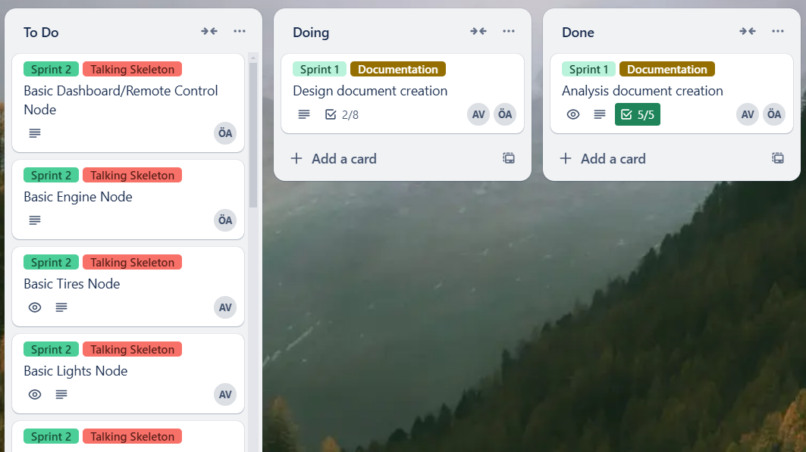
Task separation

Slide 3
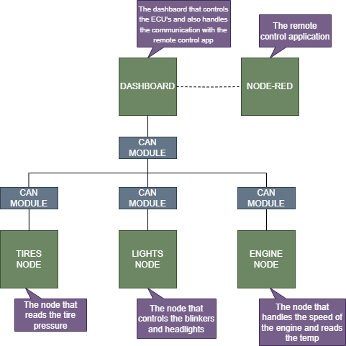
Initial design

Slide 4
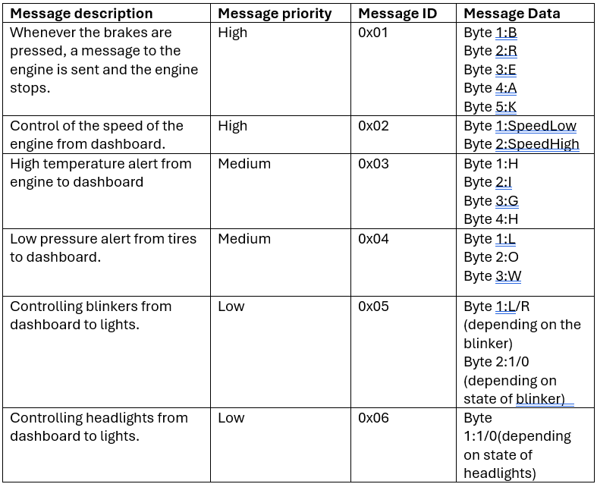
Message protocol

Slide 5
TO do
-Complete design document
-Start implementation of nodes with basic functionality for talking skeleton

Slide 6
Questions

